Slide 1
SAROJ ARYAL
MSC. IT Madrass University
OCP 10g, RHCE 6.0
Database Administration(DBA)
CSIT 7 Semister

Slide 2
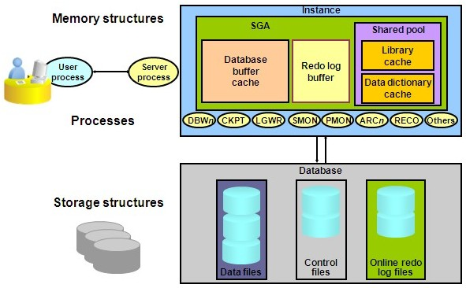
ORACLE DATABASE SERVER

Slide 3
Oracle Instance and Database
A database instance is a set of memory structures and background processes that manage database files. The instance manages its associated data and serves the users of the database.
Every running Oracle database is associated with at least one Oracle database instance. Because an instance exists in memory and a database exists on disk, an instance can exist without a database and a database can exist without an instance

Slide 4
Database Instance Structure
When an instance is started, Oracle Database allocates a memory area called the system global area(SGA) and starts one or more background processes. The SGA serves various purposes, including the following:
Maintaining internal data structures that are accessed by many processes and threads concurrently
Caching data blocks read from disk
Buffering redo data before writing it to the online redo log files
Storing SQL execution plans

Slide 5
Oracle Client
The client is a database application that initiates a request for an operation to be performed on the database server. It requests, processes, and presents data managed by the server. The client workstation can be optimized for its job. For example, it might not need large disk capacity, or it might benefit from graphic capabilities.

Slide 6
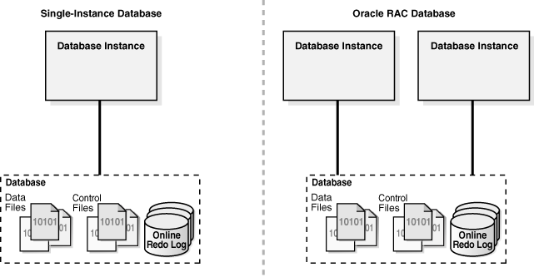
Database Instance Configurations
You can run Oracle Database in either of the following mutually exclusive configurations:
Single-instance configuration
A one-to-one relationship exists between the database and an instance.
Oracle Real Application Clusters (Oracle RAC) configuration
A one-to-many relationship exists between the database and instances

Slide 7
Oracle Database and DBMS
An Oracle database is a collection of data treated as a unit. The purpose of a database is to store and retrieve related information. It is a set of physical files on disk created by the CREATE DATABASE statement.
A database management system (DBMS) is system software for creating and managing databases. The DBMS provides users and programmers with a systematic way to create, retrieve, update and manage data.

Slide 8
Advantages of DBMS
Data abstraction and independence
Data security
A locking mechanism for concurrent access
An efficient handler to balance the needs of multiple applications using the same data
The ability to swiftly recover from crashes and errors, including restartability and recoverability
Robust data integrity capabilities
Logging and auditing of activity
Simple access using a standard application programming interface (API)
Uniform administration procedures for data

Slide 9
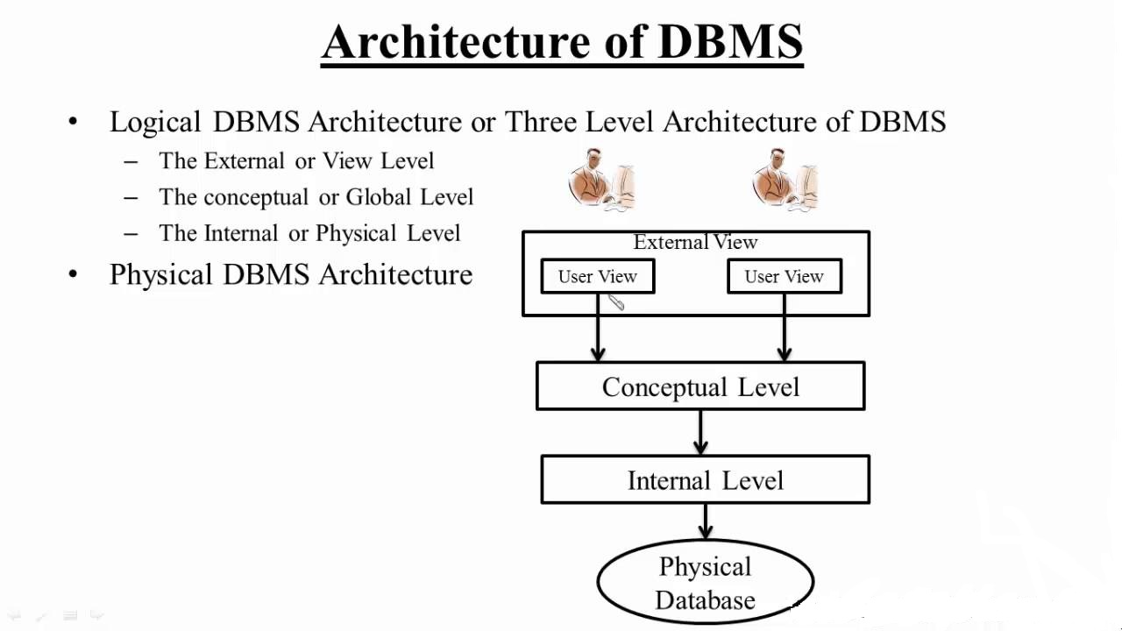

Slide 10
External Level or View Level
It is used for end user. User can interact with view level. This level describes that part of db that is relevant to each user.

Slide 11
Conceptual level or Logical Level
This describes what data is stored in db and relationship among the data.
It describes:
a) all entities, attributes and their relationship
b) constrains on the data
c) security and integrity information

Slide 12
Internal or Physical Level or Storage Level
It is the physical representation of DB. This level describes how the data is stored in DB . It covers the data structures and file organization.

Slide 13
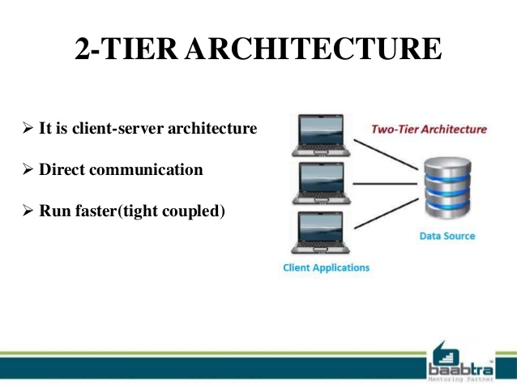
1, 2-tier, 3-tier and n-tier DBMS architecture

Slide 14
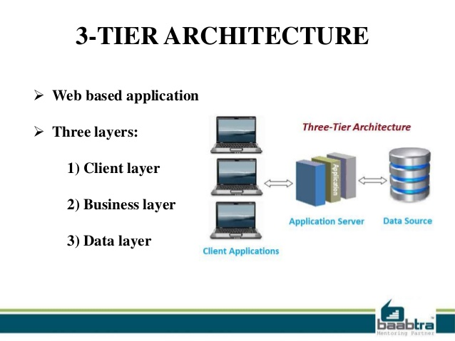

Slide 15
Data Independence
Data independency also known as data abstraction is one of the strong feature of three layered architecture of DBMS. It is the ability to change the schema at one level of the database system without affecting the other levels.
Types:
Logical data Independency
Physical data independency
Logical data independency is the ability to change the conceptual layer without affecting the external layer.
Eg: insert/delete/update data
Physical data Independency is the ability to change the internal layer without affecting the conceptual or external layer.
Eg: change of storage location, addition of indexes, tablespace changes etc.

Slide 16
DBA Roles and Responsibilities
A database administrator’s (DBA) primary job is to ensure that data is available, protected from loss and corruption, and easily accessible as needed.
Below are some of the chief responsibilities that make up the day-to-day work of a DBA:

Slide 17
1) Software installation and Maintenance
This includes installation of oracle software and database, its maintenance, application of patches, etc.
2) Data Extraction, Transformation, and Loading
Known as ETL and it refers to efficiently importing large volumes of data that have been extracted from multiple systems into a data warehouse environment.
3) Database Backup and Recovery
DBAs create backup and recovery plans and procedures based on industry best practices.
In the case of a server failure or other form of data loss, the DBA will use existing backups to restore lost information to the system. Different types of failures may require different recovery strategies, and the DBA must be prepared for any eventuality.

Slide 18
4) Security
A DBA needs to know potential weaknesses of the database software and the company’s overall system and work to minimise risks.
In the case of a security breach or irregularity, the DBA can consult audit logs to see who has done what to the data
5) Authentication
Setting up employee access and control who has access and what type of access they are allowed.
6) Capacity Planning
The DBA needs to know how large the database currently is and how fast it is growing in order to make predictions about future needs.

Slide 19
7) Performance Monitoring
Monitoring databases for performance issues is part of the on-going system maintenance a DBA performs. If some part of the system is slowing down processing, the DBA may need to make configuration changes to the software or add additional hardware capacity.
8) Database Tuning
Performance monitoring shows where the database should be tweaked to operate as efficiently as possible.
9) Troubleshooting
DBAs are on call for troubleshooting in case of any problems. Whether they need to quickly restore lost data or correct an issue to minimise damage, a DBA needs to quickly understand and respond to problems when they occur.

Slide 20
SQL*Plus Overview
SQL*Plus stands for Structured Query Language. It is command-line interface to the Oracle database which allows us to enter and execute SQL statements and PL/SQL code blocks.
Advantages:
With SQL*Plus, we can do the following:
Issue a SELECT query and view the results
Insert, update, and delete data from database tables
Submit PL/SQL blocks to the Oracle server for execution
Issue DDL commands, such as those used to create, alter, or drop database
objects such as tables, indexes, and users
Execute SQL*Plus script files
Write output to a file
Execute procedures and functions that are stored in a database

Slide 21
Operators
An operator manipulates individual data items and returns a result. The data items are called operands or arguments. Operators are represented by special characters or by keywords. For example, the multiplication operator is represented by an asterisk (*) and the operator that tests for nulls is represented by the keywords IS NULL.

Slide 22
Unary and Binary Operators
The two general classes of operators are:
unary
A unary operator operates on only one operand. Eg:
SELECT * FROM orders WHERE qtysold = -1; SELECT * FROM emp WHERE sal < 0;
A binary operator operates on two operands.
SELECT sal + comm FROM emp WHERE SYSDATE - hiredate > 365;
UPDATE emp SET sal = sal * 1.1;

Slide 23
Arithmetic Operators
+, - , /,*
Concatenation Operator
SELECT 'Name is ' || ename FROM emp;
Comparison Operators
=
!= or ^= or < >
>
<
>=
<=
IN Equivalent to "= ANY
NOT IN Equivalent to “!=ALL”
ANY Compares a value to each value in a list or returned by a query.
Eg: SELECT * FROM emp WHERE sal = ANY (SELECT sal FROM emp WHERE deptno = 30);

Slide 24
BETWEEN
[Not] greater than or equal to x and less than or equal to y.
SELECT * FROM emp WHERE sal BETWEEN 2000 AND 3000;
EXISTS
TRUE if a subquery returns at least one row.
SELECT ename, deptno FROM dept WHERE EXISTS (SELECT * FROM emp WHERE dept.deptno = emp.deptno);
IS [NOT] NULL
Tests for nulls. This is the only operator that you should use to test for nulls.
SELECT ename, deptno FROM emp WHERE comm IS NULL;
ALL
Compares a value to every value in a list or returned by a query. Must be preceded by =, !=, >, <, <=, >=.
SELECT * FROM emp WHERE sal >= ALL ( 1400, 3000);
LIKE
Used for matching the content
SELECT * FROM tab1 WHERE NAME LIKE ‘BIKASH%‘
It uses ESCAPE keyword to filter special character
To search for employees with the pattern 'A_B' in their name:
SELECT ename FROM emp WHERE ename LIKE '%A\_B%' ESCAPE '\';

Slide 25
Logical Operators: NOT, AND, OR
A logical operator combines the results of two component conditions to produce a single result based on them or to invert the result of a single condition.
NOT
Returns TRUE if the following condition is FALSE. Returns FALSE if it is TRUE. If it is UNKNOWN, it remains UNKNOWN.
SELECT * FROM emp WHERE NOT (job IS NULL);
SELECT * FROM emp WHERE NOT (sal BETWEEN 1000 AND 2000);

Slide 26
AND
Returns TRUE if both component conditions are TRUE. Returns FALSE if either is FALSE. Otherwise returns UNKNOWN.
SELECT * FROM emp WHERE job = 'CLERK' AND deptno = 10;
OR
Returns TRUE if either component condition is TRUE. Returns FALSE if both are FALSE. Otherwise returns UNKNOWN.
SELECT * FROM emp WHERE job = 'CLERK' OR deptno = 10;

Slide 27
Producing Readable Output with SQL*Plus
Produce queries that require an input variable
Use SQL*Plus substitution variables to temporarily store values.
Single ampersand (&)
Double ampersand (&&)
DEFINE and ACCEPT commands

Slide 28
Pass variable values between SOL statements.
& is used to create a temporary substitution variable that will prompt you for a value every time it is reffered.
Eg: SQL> SELECT sal FROM emp WHERE ename = '&NAME'; Enter value for name: SCOTT old 1: SELECT sal FROM emp WHERE ename = '&NAME' new 1: SELECT sal FROM emp WHERE ename = 'SCOTT' SAL ---------- 3000

Slide 29
&& - is used to create a permanent substitution variable for the session. Once you have entered a value its value will used every time the variable is referenced.
Eg: SQL> SELECT sal FROM emp WHERE ename LIKE '&&NAME'; Enter value for name: SCOTT old 1: SELECT sal FROM emp WHERE ename LIKE '&&NAME' new 1: SELECT sal FROM emp WHERE ename LIKE 'SCOTT' SAL ---------- 3000 SQL> / old 1: SELECT sal FROM emp WHERE ename LIKE '&&NAME' new 1: SELECT sal FROM emp WHERE ename LIKE 'SCOTT' SAL ---------- 3000

Slide 30
Specifying Column Names, Expressions, and Text at Runtime
Use substitution variables to supplement the following:
•WHERE condition
•ORDER BY clause
•Column expression
•Table name
•Entire SELECT statement
SELECT empno, &column_name FROM emp WHERE &condition;
Enter value for column_name: job
Enter value for condition: deptno=10
old 3: WHERE &condition
new 3: WHERE deptno=10

Slide 31
SELECT empno, ename, &column_name FROM emp WHERE &condition ORDER BY &order_column ;
Enter value for column_name : sal
Enter value for condition : sal >= 3000
Enter value for order aolumn : ename

Slide 32
The ACCEPT Command
Creates a customized prompt when accepting user input. When using the ACCEPT command, use single quotation marks (' ') to enclose a string that contains an embedded space.
ACCEPT dept PROMPT ‘ Provide the department name: ‘
SELECT * FROM dept WHERE dname = UPPER( ‘&dept’ ) ;
Provide the department name: sales
old 3: WHERE dname= UPPER('&dept')
new 3: WHERE dname= UPPER('sales')

Slide 33
Using the DEFINE Command
Use the DEFINE cornmand to create a variable and then use the variables:
DEFINE occupation=clerk
SELECT * FROM emp WHERE job = UPPER( '&occupation' );
old 3: WHERE job = UPPER( '&occupation' )
new 3: WHERE job = UPPER( 'clerk' )
Using UNDEFINE Commands
A variable remains defined until you either:
-- Use the UNDEFINE command to clear it
-- Exit SQL*Plus
We can verify the changes with the DEFINE command.

Slide 34
Data types in Oracle
CHAR Datatype
The CHAR datatype stores fixed-length character strings.
VARCHAR2 and VARCHAR Datatypes
The VARCHAR2 datatype stores variable-length character strings. When you create a table with a VARCHAR2 column, you specify a maximum string length (in bytes or characters) between 1 and 4000 bytes for the VARCHAR2 column.
The VARCHAR datatype is synonymous with the VARCHAR2 datatype. To avoid possible changes in behavior, always use the VARCHAR2 datatype to store variable-length character strings.

Slide 35
LOB Character Datatypes
The LOB datatypes stores character data and they can store up to 8 terabytes of character data.
The LOB datatypes BLOB, CLOB, NCLOB, and BFILE enable you to store and manipulate large blocks of unstructured data (such as text, graphic images, video clips, and sound waveforms) in binary or character format. They provide efficient, random, piece-wise access to the data.
NUMBER Datatype
The number datatypes store positive and negative fixed and floating-point numbers, zero, infinity
DATE Datatype
The DATE datatype stores point-in-time values (dates and times) in a table. The DATE datatype stores the year (including the century), the month, the day, the hours, the minutes, and the seconds (after midnight), format is DD-MON-YY

Slide 36
Files in Oracle Database
Parameter Files
Alert Log Files
Trace Files
Data Files
Temp Files
Control Files
Redo Log Files
Password Files

Slide 37
Control Files
A control file is a binary file which contains information about the associated database that is required for access by an instance, both at startup and during normal operation. Control file information can be modified only by Oracle; no database administrator or user can edit a control file.

Slide 38
Among other things, a control file contains information such as:
The database name
The timestamp of database creation
The names and locations of associated datafiles and redo log files
Tablespace information
The log history
Archived log information
Backup set and backup piece information
Backup datafile and redo log information
Datafile copy information
The current log sequence number
Checkpoint information
Control files also record information about checkpoints. Every three seconds, the checkpoint process (CKPT) records information in the control file about the checkpoint position in the redo log. This information is used during database recovery to tell Oracle that all redo entries recorded before this point in the redo log group are not necessary for database recovery; they were already written to the datafiles.

Slide 39
Multiplexed Control Files
Oracle enables multiple, identical control files to be open concurrently and written for the same database. By storing multiple control files for a single database on different disks, we can safeguard against a single point of failure with respect to control files. If a single disk that contained a control file crashes, then the current instance fails when Oracle attempts to access the damaged control file. However, when other copies of the current control file are available on different disks, an instance can be restarted without the need for database recovery.
We can have maximum of 5 copies of control files in one database.
It is strongly recommended that you adhere to the following:
Use multiplexed control files with each database
Store each copy on a different physical disk
Use operating system mirroring
Monitor backups

Slide 40
Multiplexing Control Files Using init.ora
Shut down the database.
Copy the control file to more locations by using an operating system command.
Change the initialization parameter file to include the new control file name(s) in the parameter CONTROL_FILES
Eg: add following lines in init.ora file
CONTROL_FILES = (‘/ora01/oradata/MYDB/ctrlMYDB01.ctl’, ‘/ora02/oradata/MYDB/ctrlMYDB02.ctl’, ‘/ora03/oradata/MYDB/ctrlMYDB03.ctl’)
Start up the database using init.ora file
For permanent defining control file in multiple locations, create spfile from init.ora file

Slide 41
Multiplexing Control Files Using an SPFILE
Multiplexing using an SPFILE is similar to multiplexing using init.ora; the major difference being how the CONTROL_FILES parameter is changed.
Follow these steps:
Alter the SPFILE while the database is still open:
SQL> ALTER SYSTEM SET CONTROL_FILES =
‘/ora01/oradata/MYDB/ctrlMYDB01.ctl’, ‘/ora02/oradata/MYDB/ctrlMYDB02.ctl’, ‘/ora03/oradata/MYDB/ctrlMYDB03.ctl’, ‘/ora04/oradata/MYDB/ctrlMYDB04.ctl’ SCOPE=SPFILE;
This parameter change will only take effect after the next instance restart by using the SCOPE=SPFILE qualifier. The contents of the binary SPFILE are changed immediately, but the old specification of CONTROL_FILES will be used until the instance is restarted.
Shut down the database.
SQL> SHUTDOWN NORMAL
Copy an existing control file to the new location:
$ cp /ora01/oradata/MYDB/ctrlMYDB01.ctl
/ora04/oradata/MYDB/ctrlMYDB04.ctl
Start the instance.
SQL> STARTUP

Slide 42
Using OMF to Manage Control Files
DB_CREATE_ONLINE_LOG_DEST_n is specified in init.ora file
n is the number of desired control files to be created. The actual names of the control files are system generated and can be found in the alert logs located in $ORACLE_HOME/admin/bdump.

Slide 43
Querying Control File Information
V$CONTROLFILE lists the names of the control files for the database
You can also use the SHOW PARAMETER command to retrieve the names of the control files.
SQL> show parameter control_files

Slide 44
Manually Creating Control File
ALTER DATABASE BACKUP CONTROLFILETO '/oracle/backup/control.bkp';
OR
ALTER DATABASE BACKUP CONTROLFILE TO TRACE;

Slide 45
Redo Log Files
Redo LOg files:
Is the transaction log of the database. By following the redo log file we can take database to any desired state.
Redo log files are filled with redo records. A redo record, also called a redo entry, is made up of a group of change vectors, each of which is a description of a change made to a single block in the database. For example, if you change a salary value in an employee table, you generate a redo record containing change vectors that describe changes to the database.

Slide 46
Redo records are buffered in a circular fashion in the redo log buffer of the SGA and are written to one of the redo log files by the Log Writer (LGWR) database background process. Whenever a transaction is committed, LGWR writes the transaction redo records from the redo log buffer of the SGA to a redo log file, and assigns a system change number (SCN) to identify the redo records for each committed transaction.

Slide 47
Log Switch Operations
The LGWR process writes to only one redo log file group at any time. The file that is actively being written to is known as the current log file
Manual log switch:
ALTER SYSTEM SWITCH LOGFILE

Slide 48
Multiplexing Redo Log Files
To protect against a failure involving the redo log itself, Oracle Database allows a multiplexed redo log, meaning that two or more identical copies of the redo log can be automatically maintained in separate locations. For the most benefit, these locations should be on separate disks.
When redo log files are multiplexed, LGWR concurrently writes the same redo log information to multiple identical redo log files, thereby eliminating a single point of redo log failure.
Syntax:
ALTER DATABASE ADD LOGFILE GROUP 1 ('/oracle1/dbs/log101.log', '/oracle2/dbs/log102.log') SIZE 4M;
ALTER DATABASE ADD LOGFILE GROUP 2 ('/oracle1/dbs/log201.log', '/oracle2/dbs/log202.log') SIZE 4M;

Slide 49
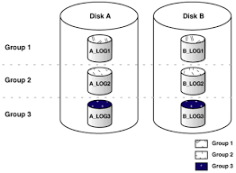
Multiplexing is implemented by creating groups of redo log files. A group consists of a redo log file and its multiplexed copies. Each identical copy is said to be a member of the group. Each redo log group is defined by a number, such as group 1, group 2, and so on.
Here, A_LOG1 and B_LOG1 are both members of Group 1, A_LOG2 and B_LOG2 are both members of Group 2, and so forth. Each member in a group must be exactly the same size.
First LGWR writes concurrently to both A_LOG1 and B_LOG1. Then it writes concurrently to both A_LOG2 and B_LOG2, and so on. LGWR never writes concurrently to members of different groups

Slide 50
Creating New Groups
You can create and add more redo log groups to the database by using the ALTER DATABASE command:
ALTER DATABASE ADD LOGFILE GROUP 3 (‘/ora02/oradata/MYDB01/redo0301.log’, ‘/ora03/oradata/MYDB01/redo0402.log’) SIZE 10M;
To create a new group without multiplexing, use the following statement.
ALTER DATABASE ADD LOGFILE
‘/ora02/oradata/MYDB01/redo0301.log’ REUSE;

Slide 51
Adding New Members
If you forgot to multiplex the redo log files when creating the database or if you need to add more redo log members, you can do so by using the ALTER DATABASE command:
ALTER DATABASE ADD LOGFILE MEMBER
‘/ora04/oradata/MYDB01/redo0203.log’ TO GROUP 2;
Renaming Log Members
Shut down the database (a complete backup is recommended).
Copy/rename the redo log file member to the new location by using an operating system command.
Start up the instance and mount the database (STARTUP MOUNT).
Rename the log file member in the control file. Use ALTER DATABASE RENAME FILE ‘<old_redo_file_name>’ TO ‘<new_redo_file_name>’;
Open the database (ALTER DATABASE OPEN).

Slide 52
Dropping Redo Log Groups
ALTER DATABASE DROP LOGFILE GROUP 3;
Note: Group must have log file in INACTIVE state. If its in active or current state/status, run the following command till the desired log group’s log file is INACTIVE:
ALTER SYSTEM SWITCH LOGFILE;
Dropping Redo Log Members
To drop the log member, use the DROP LOGFILE MEMBER clause of the ALTER DATABASE command.
ALTER DATABASE DROP LOGFILE MEMBER ‘/ora04/oradata/MYDB01/redo0203.log’;

Slide 53
Log status
UNUSED - Online redo log has never been written to. This is the state of a redo log that was just added, or just after a RESETLOGS, when it is not the current redo log.
CURRENT - Current redo log. This implies that the redo log is active. The redo log could be open or closed.
ACTIVE - Log is active but is not the current log. It is needed for crash recovery. It may be in use for block recovery. It may or may not be archived.
CLEARING - Log is being re-created as an empty log after an ALTER DATABASE CLEAR LOGFILE statement. After the log is cleared, the status changes to UNUSED.
CLEARING_CURRENT - Current log is being cleared of a closed thread. The log can stay in this status if there is some failure in the switch such as an I/O error writing the new log header.
INACTIVE - Log is no longer needed for instance recovery. It may be in use for media recovery. It might or might not be archived.

Slide 54
Archive Log Files
When an online redo log file is full, and LGWR starts writing to the next redo log file, ARCn copies the completed redo log file to the archive destination and it is called Archiving.
It is possible to specify more than one archive destination. The LGWR process waits for the ARCn process to complete the copy operation before overwriting any online redo log file.
Check the archival or no archive status of database:
SQL> archive log list;
Enable Archiving
Check the archiving is enabled or not by using following command:
sql> archive log list;

Slide 55
If not then follow the steps:
Shutdown the database
sql> shutdown immediate;
Startup in mount mode
sql>startup mount;
Enable Archiving:
Alter database archivelog;
Open database:
Alter database open;
Check the archival status:
sql>archive log list;
(default to db_recovery_file_dest location)

Slide 56
Setting Archive Destination:
Two ways:
Defining in initialization parameter
Add following line in init.ora file and start database using init.ora file:
log_archive_dest_1='LOCATION=d:\arch‘
Since we are using initialization parameter, the above process require database down time
2) By running following command:
alter system set log_archive_dest_1='LOCATION=d:\arch' scope = both;
The above command updates the new archival destination and gets into effect immediately.

Slide 57
LOG_ARCHIVE_DEST Specifies the destination to write archive log files.
LOG_ARCHIVE_DUPLEX_DEST Specifies a second destination to write the archive log files. This destination must be a location on the server where the database is located
LOG_ARCHIVE_DEST_n Using this parameter, you can specify as many as five archiving destinations. These archive locations can be either on the local machine or on a remote machine where the standby database is located. When these parameters are used, you cannot use the LOG_ARCHIVE_DEST or LOG_ARCHIVE_DUPLEX_DEST parameters to specify the archiving location.

Slide 58
LOG_ARCHIVE_FORMAT Specifies the format in which to write the filename of the archived redo log files. It takes following variables:
%s Log sequence number
%S Log sequence number, zero filled
%t Thread number
%T Thread number, zero filled
Eg: LOG_ARCHIVE_FORMAT = ‘arch_%t_%s’ then archive file name will be like arch_1_101
If LOG_ARCHIVE_FORMAT = ‘arch_%S’ then archive file name will be like arch_00000101
LOG_ARCHIVE_MAX_PROCESSES Specifies the maximum number of ARCn processes Oracle should start when starting up the database. By default the value is 1.

Slide 59
Disable Archiving
Shutdown the database
Sql>shutdown immediate;
Startup in mount mode
Sql>startup mount;
Run the following command
Sql>alter database noarchivelog;
Check the archival status
Sql>archive log list;

Slide 60
Practical Tasks
Query the control file location
Multiplex the control file into 3 locations
Query the redo log file and its details
Add new redo log group by enabling multiplexing
Add new redo log member in existing redo log group
Drop redo log member
Drop redo log group
Query the archival status
Enable Archival to new location
Disable Archival

Slide 61
What is DBMS? Define 2 tier and 3 tier architecture of DBMS (10 marks).
Define Oracle Database and Oracle Instance (5 marks).
What are the roles of DBA ? (5 marks)
What is Control file? Describe multiplexing of controlfile in detail. (10 marks)
What is redo log file ? Describe importance of multiplexing redo log file along with steps. (10 marks)

Slide 62
Chapter 3
User
In Oracle, users and schemas are essentially the same thing. You can consider that a user is the account you use to connect to a database, and a schema is the set of objects (tables, views, etc.) that belong to that account.
What is user management?
User management is to create and manage login credentials, assign roles and privileges, assign limits, etc. for each user.

Slide 63
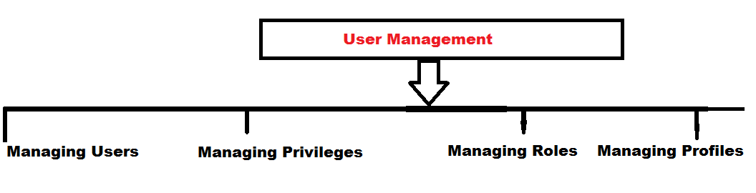

Slide 64
1 ) Create User - We can create new user by using "Create User" statement -Before executing this statement we must have "Create user" system privilege -It's a powerful privilege, a DBA or security administrator is normally have this privilege
Eg: create user ram Identified by ram;

Slide 65
We can define user default tablespace, quota limit and temporary tablespace during user creation:
Eg: create user sam identified by sam
default tablespace zen
quota 20m on zen;
2) Alter User -To change user password and account limitations
alter user ram identified by reena;
i) Alter space with limit:
alter user sam quota 25m on zen;
here the user quota in zen tablepsce is changed.
ii) Alter space with unlimited
alter user sam quota unlimited on zen;

Slide 66
To View Quota Allocation
i) DBA Level
select * from dba_ts_quotas;
ii) User Level
select * from user_ts_quotas;
To view default tablespace
SQL> col property_name for a25
SQL> col property_value for a28
SQL> select property_name,property_value from database_properties;
To view username and passwords
select username,password from dba_users;

Slide 67
LOCK/UNLOCK USERS;
select username,account_status
from dba_users;
alter user ram identified by ram;
alter user ram account unlock;
OR
alter user ram identified by ram account unlock;
To lock the user account
i)Lock
alter user ram password expire account lock;
ii)Lock separation
alter user ram password expire;
alter user ram account lock;

Slide 68
3) DROP USER
Initiate DROP command to drop the user.
eg: drop user tt;
If tt user owns object then we must user CASCADE command to drop user.
eg: drop user tt cascade;
The CASCADE command is used to drop the user along will all the objects and attributes associated to that user.

Slide 69
What is privilege / User privilege?
- Privilege is nothing but to give users access rights for that particular objects in oracle
- Privileges are granted or revoked by the instance administrator user
- A user privilege is a right to execute a particular type of SQL statement, or a right to access another user's object
Types of Privileges
SYSTEM Privileges
Object Privileges

Slide 70
SYSTEM Privileges
A system privilege is the right to perform a particular action, or to perform an action on any schema objects of a particular type. For example, the privileges to create tablespaces and to delete the rows of any table in a database are system privileges. There are over 60 distinct system privileges.
examples:
CREATE TABLE CREATE CLUSTER CREATE TRIGGER CREATE OPERATOR CREATE SEQUENCE CREATE INDEX CREATE PROCEDURE
etc..

Slide 71
Who Can Grant or Revoke System Privileges?
Only users who have been granted a specific system privilege with the ADMIN OPTION or users with the system privileges GRANT ANY PRIVILEGE or GRANT ANY OBJECT PRIVILEGE can grant or revoke system privileges to other users.
2) Schema Object Privileges
A schema object privilege is a privilege or right to perform a particular action on a specific schema objects: Table, View, Sequence, Procedure, Function, Package, etc.

Slide 72
Object Privileges could be :
SELECT Privilege to perform SELECT statements on the table.
INSERT Privilege to perform INSERT statements on the table.
UPDATE Privilege to perform UPDATE statements on the table.
DELETE Privilege to perform DELETE statements on the table.
REFERENCES Privilege to create a constraint that refers to the table.
ALTER Privilege to perform ALTER TABLE statements to change the table definition.
INDEX Privilege to create an index on the table with the create index statement.
ALL All privileges on table.

Slide 73
Views of object privs
1)USER_TAB_PRIVS
2)ALL_TAB_PRIVS
3)ROLE_TAB_PRIVS
4)DBA_TAB_PRIVS

Slide 74
Roles
- Role is a set of privileges that can be granted to users or to other roles
We can add privileges to roles and then grant the role to a user.
Views of roles
1) USER_ROLE_PRIVS
2)ALL_ROLE_PRIVS
3)ROLE_ROLE_PRIVS
4)DBA_ROLE_PRIVS
Creating Role:
Syntax:
create role <role_name>;
Example:
Create role manager;

Slide 75
- Grant Privileges to role:
sql> grant create table, create view to manager;
Assign role to role:
sql>create role account;
sql> grant manager to account;
Drop roles
logon on sys user and drop the roles
SQL> drop role manager;
SQL> drop role account;

